Slide 1
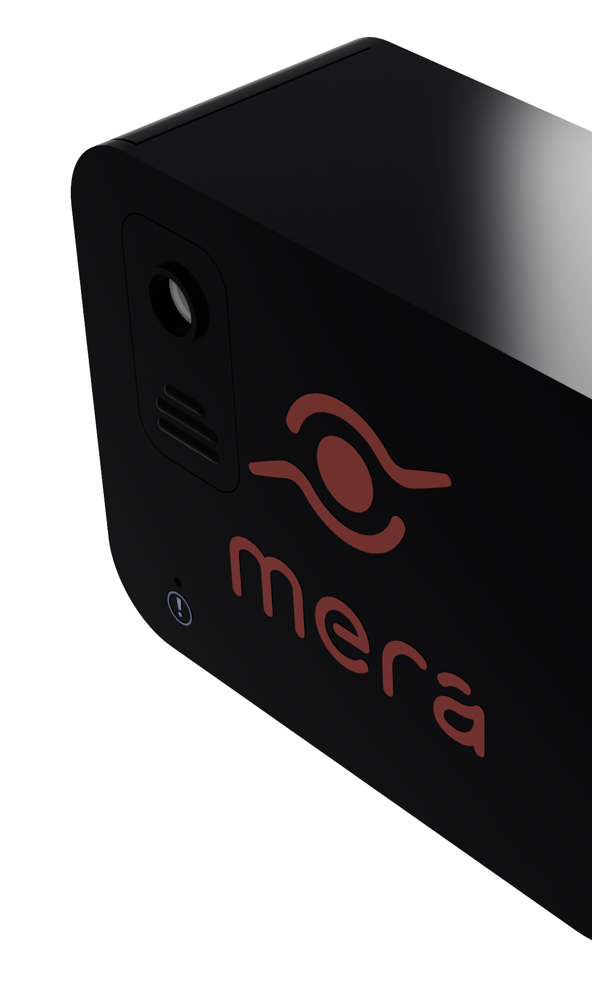
MERA Lift
Requirements

Slide 2
Commercial Claims
SHALL - Commercial Claims
Product shall determine people’s gender with acceptable accuracy | Product shall update to dashboard frequently | Dashboard shall display Reach based on time and place
Product shall determine ads Reach with acceptable accuracy | Product shall detect which advertisement is displayed | Dashboard shall display Impression based on time and place
Product shall determine ads Impression with acceptable accuracy | Product shall be secure in handling data | Dashboard shall display gender based on time and place
Product shall determine people’s age with acceptable accuracy | Product shall have long run time | Dashboard shall display age based on time and place

Slide 3
User Safety and Comfort
MUST - User Safety and Comfort
MERA Lift - Product must be quiet in normal and abnormal operations | Product must have abnormal case detections and abnormal shutdown procedure | Product must be electrically insulated in normal and abnormal operations
Product must not emit excess heat in normal and abnormal operations | Data collected must be honestly disclosed with regards to its use | Product must be firmly mounted on the lift wall
Product must not emit toxic materials in normal and abnormal operations | Product must be environmentally friendly

Slide 4
Design Excellence
SHOULD - Design Excellence
Product should update to server frequently | Dashboard should be aesthetically pleasing | Product should determine stay duration of people in the lift with acceptable accuracy
Product should be aesthetically pleasing | Product design should be minimalistic | Product should be serviceable
Product should clearly show MERA brand | Product device status should be monitored in the dashboard | Dashboard design should be minimalistic
Product should be resilient to lay people tampering | Product should be operable in natural light conditions | Dashboard should be visually displayed in graphs

